Slide 1
Rough Sleeping in London Borough of Tower Hamlets
Fleur Holley-Moore
Rough Sleeping Manager
London Borough of Tower Hamlets

Slide 2
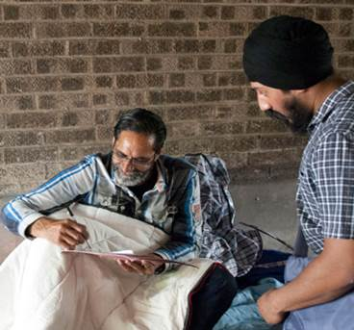
What is our vision
A shared commitment with the government to end rough sleeping
Harmful to the individual and the wider community
It is of increasing public concern and distress, particularly because of our growing cohort of rough sleepers with complex needs

Slide 3
CHAIN Figures

Slide 4
Rough Sleeping Figures

Slide 5
LBTH rough sleeping clients
66% British; 19% EEA Nationals, 8% African, 6% Asian
81% Male; 19% Female
6% 18-25 years, 28% 26-35 years, 40% 36-40 years, 19% 46-55 years, 7% over 55
Concentrated in the west of the borough

Slide 6
LBTH rough sleeping clients
More than one high support need
High drug and/or alcohol use
Higher proportion with poor mental health than the London average
In and out of the hostel pathway –’revolving door’
Engage in street activity / ASB

Slide 7
Support Needs

Slide 8
Challenges in supporting rough sleepers
High support need client group
Inflexibility of mainstream services (e.g. GPs)
Local connection rules
Having the right offer of accommodation at the right time
Use of tents

Slide 9
LBTH funded provision
Outreach Team – TH SORT
Advice and Support team and an outreach psychotherapist at Providence Row Day Service
Navigators
Specialist drug and alcohol outreach and recovery service
Supported Accommodation Pathway
All year emergency bed spaces, with additional spaces during extreme cold weather
Housing First pilot
No First Night Out Initiative

Slide 10
TH SORT
Large and experienced outreach team to assess, engage and support individuals off the streets
Approx. 7 shifts a week with a mixture of late and early shifts
Many specialisms within the team:
Health coordinator
In Reach Worker
Approved Mental Health Practitioner
LOS worker

Slide 11
Housing First pilot
5-unit Housing First pilot in partnership with Poplar HARCA
For those who have multiple and complex needs and have exhausted their options in our hostel pathway
Dedicated Housing First worker to provide intensive and wraparound support
Early positive outcomes

Slide 12
Trauma Informed Outreach Psychotherapist
To test the boundaries of the traditional psychotherapist model
Primary aim is to support our complex needs returners who find it difficult to remain in accommodation due to past trauma
Last year worked with 42 individuals

Slide 13
SWEP Provision
A mixture of provision in our hostel and at Providence Row
A total of 31 bed spaces + 15 comfy chairs + Pan-London provision
Space for men, women, couples, dogs, cats, those excluded from our hostel sector
Crash pad for intense engagement

Slide 14
Pan-London Services
Street Link
No Second Night Out
Pan-London activation and deactivation of SWEP and Pan-London provision
Clearing House
Case coordinators – SIB
Safe connections
Routes Home

Slide 15
Street Link
Online and App reporting tool for rough sleepers
Self report or members of the public can for someone who they are concerned about
Ensure the rough sleeper is quickly linked up to essential support services
Option to request feedback on a referral

Slide 16
No Second Night Out
Launched in 2011, and rolled out London wide in 2012
Rapid intervention aimed at new rough sleepers so they need not spend a second night on the street
3 hubs across London and staging posts – aim of a 72 hour turn around into accommodation

Slide 17
SIB Workers
Social Impact Bond – payment by results
Case workers that work with a defined cohort of our most entrenched and complex rough sleepers
Outcomes include:
Entering and sustaining accommodation
Improving health and wellbeing
Engaging with substance misuse
Educational and employment opportunities

Slide 18
Looking into the future
Bidding for next round of Rough Sleeping Initiative funding
Rapid response Street Outreach
Improving accommodation pathways for women involved in prostitution
Improving links with faith based sector

Slide 19
How the faith based sector can help
A lot of volunteering opportunities in the borough
Having an awareness of services to help rough sleepers and the complexities of the group
Excellent guidance available for starting a night shelter and some funding to do so
We’re keen to work with you!

Slide 20
Any Questions?
Fleur.Holley-Moore@Towerhamlets.gov.uk

