Slide 1
Central East Basic Command Unit
Tower Hamlets – Inter Faith Forum
Monday 30th January 2023

Slide 2
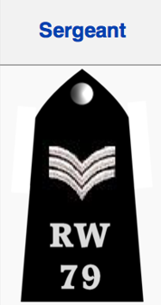
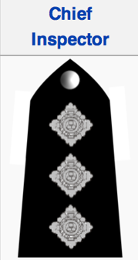
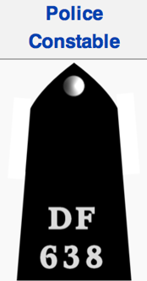
CE Structure
BCU Commander
Lead officer for Bethnal Green and Hackney
33 Inspectors on the BCU that lead individual teams
285 Volunteer Special Constables
159 Sergeants, first level line management in the organisation
Additionally, we have 76 members of support staff including PCSO’s, Public Access Officers & Investigators. This does not include the LDSS staff who work within the buildings assisting with property, fleet, uniform and facilities management.
There is also forensics management and scenes of crime officers that are civilians and managed by another command but based within Central East BCU.
5 Superintendents leading on the individual strands
11 Chief Inspectors across the Strands
1120 Constables

Slide 3
Central East Local Crime Priorities
‘Less Crime. More Trust. Higher Standards.’
Street based violence (inc. knife and gun crime)
Robbery
Burglary
ASB (+ Drug related ASB)
VAWG
Sexual offences
Domestic Abuse
Hate Crime
Child Sexual Exploitation

Slide 4
How Does CE Operate
There are five core operating strands across the BCU - each led by a Superintendent.
HQ – Professional Standards, Performance, Criminal Justice, Finance and Special Constabulary
Local Investigations – Reactive investigations, Gangs, Robbery, Burglary, Violent Suppression, Forensic Conversion, Digital Image Retrieval and Crime Squad
Public Protection – Domestic & Child Abuse, Sexual Offences, Exploitation, High Risk Missing Persons, Jigsaw, MARAC, MASH, Indecent Images of Children, IOM (Integrated Offender Management)
Emergency Response – 24/7 call and incident response, local investigations, Mispers, Local Resolution Team and BCU Operations Room.
Neighbourhoods – Ward and community policing, partnership, prevention and problem solving, Schools, Youth Engagement, Night Time Economy and Neighbourhood Task Force
The BCU is also supported by:
LDSS (Local Support Services) – exhibit property management, supplies, services and BCU support
Forensics - crime scene and investigative support
Learning & Development – Probationer training (Detective and Uniform) & professional development

Slide 5
Overview of CE Neighbourhood Strand
20 Ward teams – each with two Dedicated Ward Officers (DWOs) and a PCSO. Overseen by a Sergeant in charge of three wards – ward panels, priorities, community engagement, local officers understanding and responding to local issues
Licensing team – small but brilliantly effective, working across the Borough – leading the way across the UK.
ASB Team – manage info sharing, ASB interventions and enforcement
Faith and Hate officers – Supporting all communities. Bringing communities, partners and faith/hate group together to tackle hate crime.
Schools Officers – providing expert support to the secondary schools who are part of the SSP.
Youth Engagement Team – Engaging with young people & establishing scrutiny pathways through established youth groups
Cadet Coordinator – supporting a fantastic, representative cohort of over 100 Cadets – now direct

Slide 6
Overview of CE Emergency Response Strand
I Calls & S calls
(For context, I and S calls in Tower Hamlets account for about 54% of total I/S grades for the BCU)
15660 I calls in TH in 2022 (over 40 per day)
Over the last year we’ve attended 85.4% of these within 15 minutes.
18630 S calls in Tower Hamlets in 2022 (just over 51 per day)
Over the last year we’ve attended Roughly 74% of these within an hour.
Crime Investigations in Hackney (last six months)
OIC for roughly 7000 investigations
1,000 arrests
200 Stop/Search arrests
4000 (last six months)
Critical incidents, Local and Central Aid

Slide 7
Overview of CE Public Protection
Our Public Protection strand is made up of approximately 250 staff who work across 14 departments:
CAIT – All child abuse from common assault to attempted murder
Sapphire – Approximately 600 rape offences a year
OCSAE – Online images. Including referrals from America and partner agencies. Then conducts
warrant, seizes evidence, reviews devices and then grades images. Sometimes 10,000+
Missing persons – Main concern for us are young people involved in CSE or CCE
CSU – Domestic Abuse – thousands of offences a year 3000+
Jigsaw – Monitoring of over 700 offenders across CE
POU – Proactive Unit focussing on high Harm Offenders
Exploitation Team – both adult and child – sexual, servitude, criminal and slavery
Relies on a strong partnership and embedded staff working within both councils.

Slide 8
Overview of CE Local investigations
Local Investigation teams focus on violence as a priority, working across 9 different teams which include;
CID – Investigation of serious and complex crime
Burglary & Robbery Investigation Team (BRIT) – Responsible for the secondary investigation and proactive response.
Forensic Conversion Team – Investigating DNA and fingerprint identifications taken from crime scenes.
Image Retrieval Unit – Deployed to scope and retrieve footage of incidents from violent crime to vulnerable victims.
Gangs Task Force – Focusing on the violence that the high harm gangs bring and the safeguarding of them.
Integrated Gangs Unit –
Integrated Offender Management Unit –The most persistent and problematic offenders are identified and managed jointly by partners working together.
Violence Suppression Unit – Dedicated team of uniformed officers who are able to respond to serious violence and create suppression plan in line with neighbourhood priorities and gang tensions.

Slide 9
Overview of CE Headquarters
Operational Support – managing resourcing across the Borough, including making sure our ERPT is at optimum strength, servicing events and planned and spontaneous protests
Professional Standards – Dealing with local, ow level misconduct and performance matters. Porivde a link to DPS and IOPC with regards to any more serious matters.
Finance
Criminal Justice
Specials

Slide 10
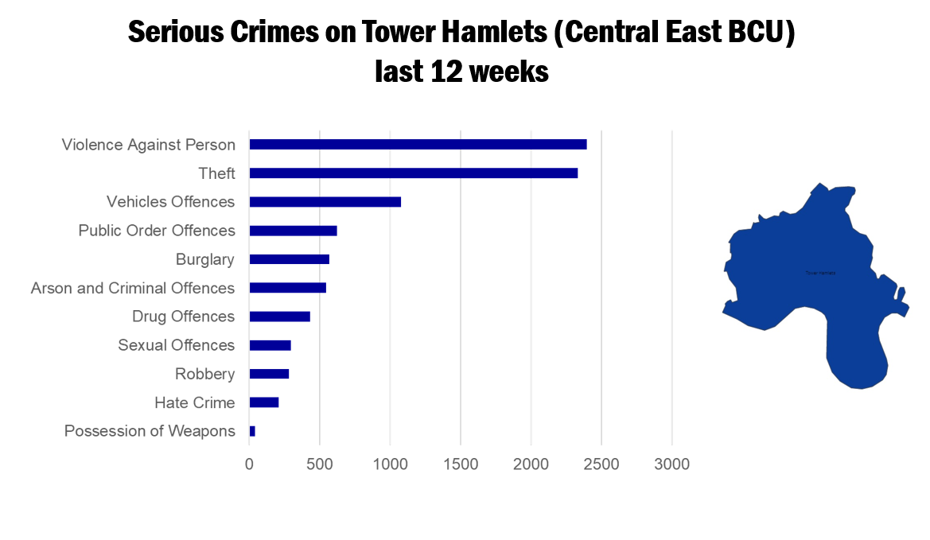

Slide 11
